Slide 1

Hungry for Dumplings?

Slide 2

Introduction
If you're like me, you love quality Asian food, more specifically Chinese dumplings. Naturally, if you are traveling to a new city, you are eager to find the best places to chow down. Thus, the problem that I will be solving for, is leveraging Chinese restaurant densities within neighborhoods of Toronto to determine where someone from out of town should go in order to fill their bellies on yummy Chinese food.

Slide 3

Data Solution Proposal
I will utilize Toronto postal code data as well as the Foursquare API to collate data findings about locations of Chinese restaurants in Toronto, ON neighborhoods. Given that Toronto is a burgeoning food city in North America, I am confident that we will be able to glean the best areas within the city to fulfill one's craving for Chinese food.

Slide 4

Methodology
Collect data from https://en.wikipedia.org/wiki/List_of_postal_codes_of_Canada:_M, then clean and process the data to a dataframe
Use Foursquare’s API to locate all Chinese restaurant venues within Toronto, along with ratings, tips, and likes that will be aggregated and appended to new dataframes
Showcase Borough, Neighborhood, and Ratings analysis for Chinese restaurant venues located throughout Toronto
Provide a suggested Toronto neighborhood and borough to find the highest quality Chinese food

Slide 5

Analysis

Slide 6
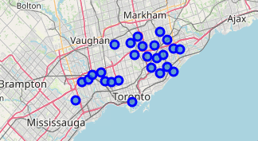
Findings
Distribution of Chinese Restaurants by Borough (Top 5):
Map of Toronto Neighborhoods:
Borough | No. of Chinese Restaurants
Scarborough | 31
North York | 18
Etobicoke | 7
York | 4
Downtown Toronto | 1
Distribution of Chinese Restaurants by Neighborhood (Top 5):
Scarborough, which is in the Northeastern quadrant of Toronto City has both the highest number of Chinese restaurants as well as the highest density of Chinese restaurants found scattered amongst Scarborough’s various neighborhoods. Apart from Bayview Village and Hillcrest Village, the Top 5 neighborhoods by Chinese restaurant count can be found in Scarborough.
Neighborhood | No. of Chinese Restaurants
Agincourt | 6
Bayview Village | 5
L’Amoreaux East | 5
L’Amoreaux West | 5
Hillcrest Village | 4

Slide 7

Rating Results

Slide 8
Final Rating Table
Neighborhood | Average Rating | Postal Code | Borough
Milliken, Agincourt North, Steeles East, L’Amoreaux East | 8.4 | M1V | Scarborough
Harbourfront East, Union Station, Toronto Islands | 7.7 | M5J | Downtown Toronto
Del Ray, Mount Dennis, Keelsdale and Silverthorn | 7.5 | M6M | York
North Park, Maple Leaf Park, Upwood Park | 7.5 | M6L | North York
Humewood-Cedarvale | 7.4 | M6C | York
Caledonia-Fairbanks | 7.4 | M6E | York
Willowdale, Willowdale West | 7.4 | M2R | North York

Slide 9
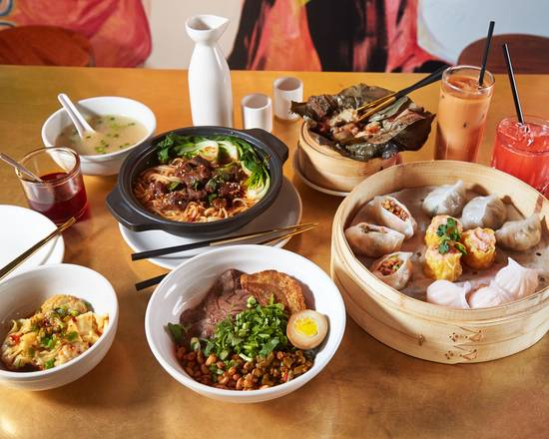
Conclusion
Milliken, Agincourt North, Steeles East, L'Amoreaux East in the Scarborough borough has the highest average rating for Chinese restaurants in the city of Toronto at: 8.4 according to Foursquare API data. However, the neighborhood with the most Chinese restaurants was Agincourt which is also located in the Scarborough borough. It makes sense that the neighborhood with the highest average rating for restaurant would be near the neighborhood with the highest density of Chinese restaurants, considering that Toronto's "Chinatown" is in the northeast portion of the city. All that said, it sounds like there are bound to be some great dumplings in the Northeastern Scarborough district if you ever find yourself visiting Toronto.

Slide 10

THANK YOU

